Slide 1
Introduction to R – Part2
Introduction to Data Science

Slide 2
Outline
Conditional Execution
if-else
ifelse
switch
Looping
while
for
Functions

Slide 3
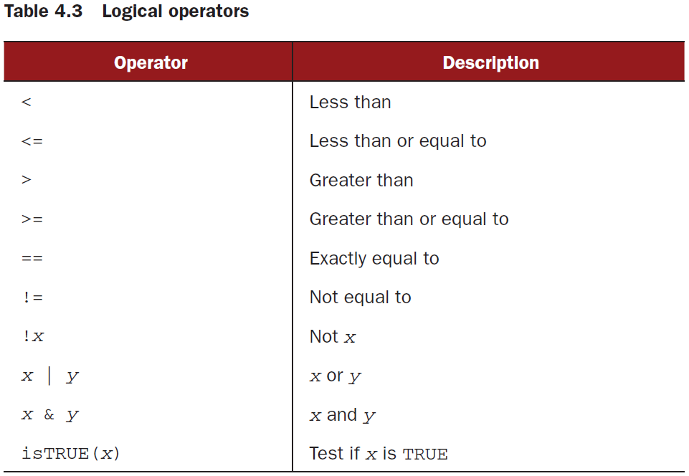
Conditional Execution

Slide 4
Looping
while
for

Slide 5
Looping: while
while (cond)
statement
i <- 1 while (i < 6) { print(i) i <- i + 1 }

Slide 6
Looping: while
i <- 1
while (i < 6) {
print(i)
i <- i + 1
if (i == 4) {
break
}
}
Output=?

Slide 7
Looping: while
i <- 1
while (i < 6) {
print(i)
i <- i + 1
if (i == 4) {
break
}
}
[1] 1
[1] 2
[1] 3

Slide 8
Looping: while
i <- 0
while (i < 6) {
i <- i + 1
if (i == 3) {
next
}
print(i)
}
Output=?

Slide 9
Looping: while
i <- 0
while (i < 6) {
i <- i + 1
if (i == 3) {
next
}
print(i)
}
[1] 1
[1] 2
[1] 4
[1] 5
[1] 6

Slide 10
Looping: for
for (var in seq)
statement
for (x in 1:10) { print(x) }
Similar to the while loop, we can use the break and the next statements for the same purposes in the same way.

Slide 11
Looping: for (nested)
for (x in 1:2) {
for (y in 1:3) {
print(x*y)
}
}
Output=?

Slide 12
Looping: for (nested)
for (x in 1:2) {
for (y in 1:3) {
print(x*y)
}
}
[1] 1
[1] 2
[1] 3
[1] 2
[1] 4
[1] 6

Slide 13
Functions
The function() keyword is used to create a function.
myfunction <- function(arg1, arg2, ... ){
statements
return(object)
}
add_numbers<- function(a,b){
sum<- a+b
return (sum) }
print(add_numbers(4,5))

